Slide 1
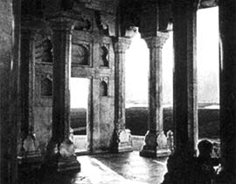
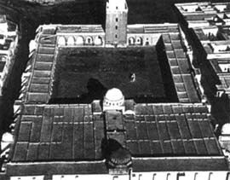
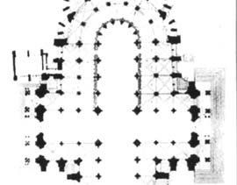
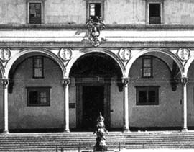
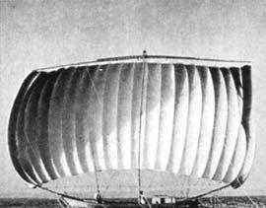
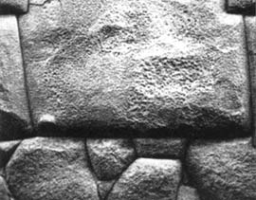
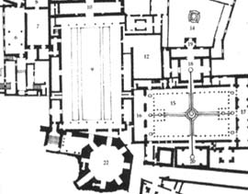
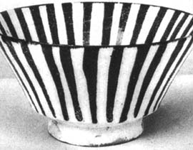
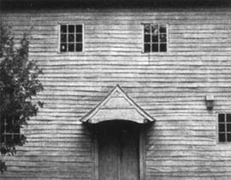
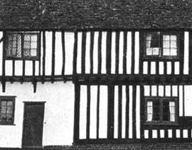
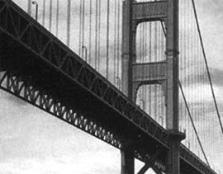
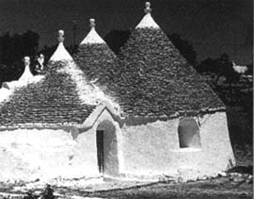
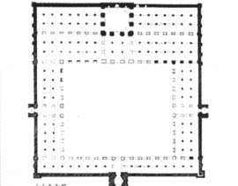
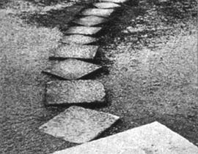
This slide set is licensed under a Creative Commons license:
Educational Taxonomy
& Pattern Approach
Are There Benefits for Educational Scenarios from Exploring Alexander's fifteen properties of living centers?
Peter Baumgartner
Reinhard Bauer
Danube University Krems

Slide 2
Outline
Patterns and Pedagogical Patterns
What is a taxonomy and why do we need it?
Alexander's 15 properties & their implication for education

Slide 3
What are Patterns?

Slide 4
“Each pattern describes a problem which occurs over and over again in our environment, and then describes the core of the solution to that problem, in such a way that you can use this solution a million times over, without ever doing it the same way twice.”
– Christopher Alexander, A Pattern Language, 1977

Slide 5
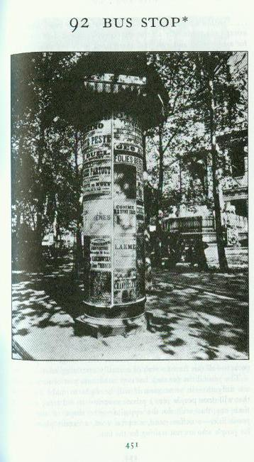
Pattern number
Pattern name
Picture from the real world that relates to the pattern and shows an architypal example of that pattern.
Alexandrian Pattern Form (1)

Slide 6
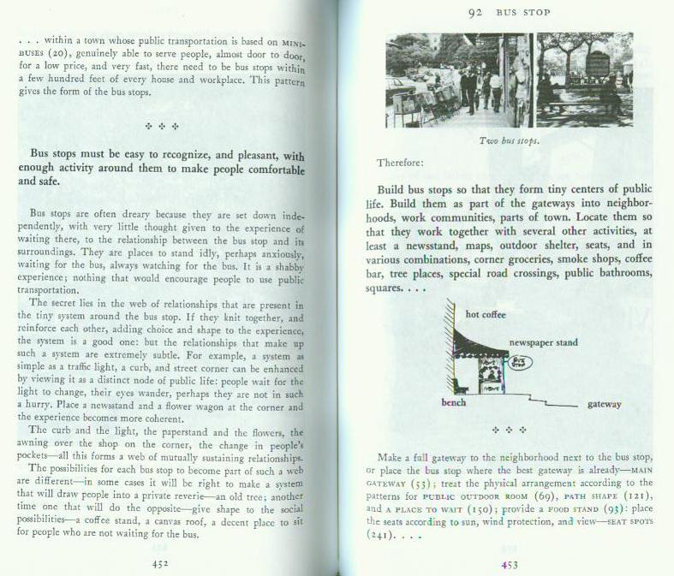
Context for the pattern which explains how to complete certain larger patterns.
Problem in 1 or 2 sentences
Solution = heart of the pattern
Forces relevant in the given problem context along with hints on how to resolve the forces.
Diagram which shows the solution
Smaller patterns and their relations to the given pattern
Alexandrian Pattern Form (2)

Slide 7
Relationships between key elements in Alexander’s pattern definition
Pattern User
Context
operates in
prioritizes
Forces
has
resolves
Problem
solves
Solution
Reproduced according to Arnold & Podehl (1999, p. 143), Meszaros & Doble (1998)

Slide 8
What are Pedagogical Patterns?

Slide 9
“Pedagogical patterns try to capture expert knowledge of the practice of teaching and learning. The intent is to capture the essence of the practice in a compact form that can be easily communicated to those who need the knowledge. Presenting this information in a coherent and accessible form can mean the difference between every new instructor needing to relearn what is known by senior faculty and easy transference of knowledge of teaching within the community. .”
– http://www.pedagogicalpatterns.org/

Slide 10
SEMINARS
A Pedagogical Pattern Language
about teaching seminars effectively
– Astrid Fricke & Markus Völter 2000

Slide 11
Why do they need a taxonomy?

Slide 12
What is a taxonomy?
I understand taxonomy as a classification schema built by a system of consistent generative principles, procedures and rules guided by a functional logic appropriate for reflecting the (assumed) mechanism of action of the classified object.
Baumgartner, 2009

Slide 13
A critical finding ...
Pedagogy has not succeeded so far in establishing a consistent taxonomy of educational scenarios.

Slide 14
Advantages of a taxonomy
Integration
Orientation
Information
Cost reduction
Transfer
Innovation
Heuristics

Slide 15
Troubles with a taxonomy
Categories
Operationalization
Structuring
Granularity

Slide 16
What is an
educational scenario?

Slide 17
Definition
As a first approximation, we can perceive it as a representation of an educational setting, which comprises of an arrangement (configuration) of social, spatial, content-related, and temporal variables (= action patterns). This definition includes both, abstracting unnecessary details of action situation and characterizing necessary conditions and environments for the implementation.
Notes:
Didaktisches Szenario: Als erste Näherung können wir darunter eine
Darstellung eines didaktischen Settings verstehen, das aus einem Arrangement
(Konfiguration) von sozialen, räumlichen, inhaltlichen und zeitlichen
Variablen gebildet wird (= Handlungsmuster). Die Beschreibung ist dabei so
gefasst, dass sie einerseits von unnötigen Einzelheiten der
Handlungssituation abstrahiert, andererseits aber auch die für die Umsetzung
notwendigen Voraussetzungen und Umgebungsbedingungen charakterisiert.

Slide 18
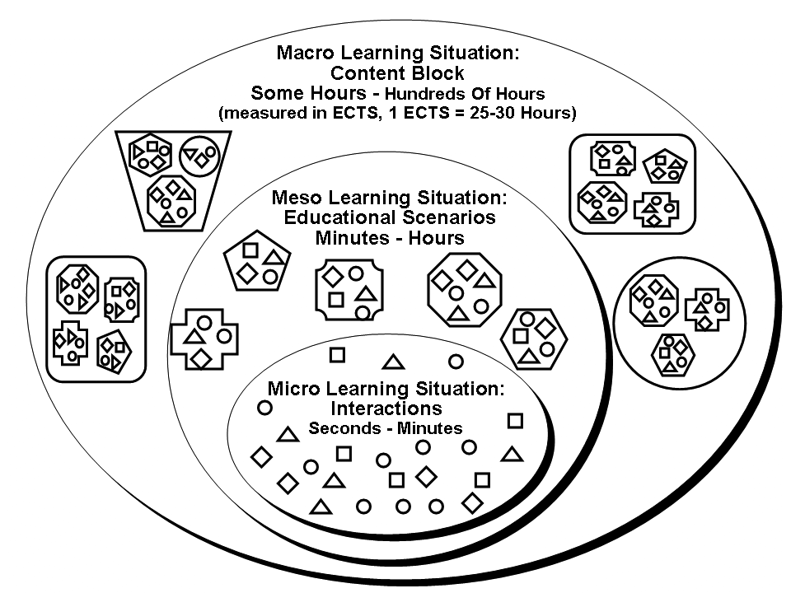
Educational Stratification Model

Slide 19
Ball Bearing Method (“Kugellager”)
Notes:
The Ball Bearing method (German: Kugellager) can be used to prevent an endless sequence of ”talks in front of an audience”. For instance, different student speakers may one by one present different eLearning standards to the audience. These series of talks tend to get boring for the audience. The activation of the learner audience is low; many times students are just waiting for
their turn to present.
To understand the specifics of the Educational Scenario Ball Bearing, we continue our above mentioned example of 40 participants of the block inside the Educational Technology II course.
For the implementation of the Ball Bearing method, we first distributed informational material on eLearning standards. In groups of four persons, the students investigated one of ten different
eLearning standards. After the group investigations, half the course participants formed an inner circle, while the other half formed an opposing outer circle. The inner circle of learners– and this is the reason for calling this Educational Scenario “Ball Bearing” – is shifted one station clockwise each time a central signal is given. During a fixed time frame (e.g., five minutes), the members of the groups in the inner circle present their findings using posters, notes or even computer presentations. The outer circle remains fixed as the inner circle wanders by a central signal (e.g. a bell) to the next station. When the circle is thus completed, the participants change roles – the inner circle people switch with the outer circle people and the second half of the Ball Bearing process begins by repetition of the procedure just described, a project work by DUK students where the Ball Bearing scenario is explained via a Flash animation in German).

Slide 20
4 Dimensions of Educational Scenarios
Alexander
Education
Social Interaction
Space
Space
Content
Time

Slide 21
Alexander's 15 Properties & Their Implication for Education

Slide 22
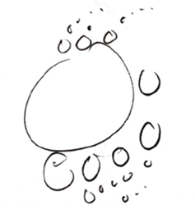
1. LEVELS OF SCALE
is the way that a strong center is made stronger partly by smaller strong centers contained in it, and partly by its larger strong centers which contain it.

Slide 23
1. LEVELS OF SCALE
Social Interaction
Space
Content
Time
Large group Small groups
Large room Small rooms
Poster, presentation
5‘ per group, total time e.g. 60‘ with 6 groups

Slide 24
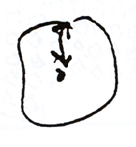
2. STRONG CENTERS
defines the way that a strong center requires a special field-like effect, created by other centers, as the primary source of its strength.

Slide 25
2. STRONG CENTERS
Social Interaction
Space
Content
Time
Peer-to-peer
Outer circle = Stations
Poster
5‘

Slide 26
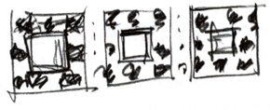
3. BOUNDARIES
is the way in which the field-like effect of a center is strengthened by the creation of a ring-like center, made of smaller centers which surround and intensify the first. The boundary also unites the center with the centers beyond it, thus strengthening it further.

Slide 27
3. BOUNDARIES
Social Interaction
Space
Content
Time
Inner/Outer Student group
Inner/Outer circle
Headline, frame of graphs, (web-) pages
Bell = Signal for rotation
Notes:
Entering room, lecture

Slide 28
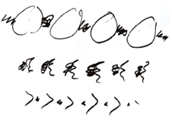
4. ALTERNATING REPETITION
is the way in which centers are strengthened when they repeat, by the insertion of other centers between the repeating ones.

Slide 29
4. ALTERNATING REPETITION
Social Interaction
Space
Content
Time
Presentation to all the other groups
Everybody part of outer/inner circle
Talking / Listening
5‘/5‘… 30‘/60‘
Notes:
Time table

Slide 30
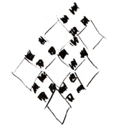
5. POSITIVE SPACE
is the way that a given center must draw its strength, in part, from the strength of other centers immediately adjacent to it in space.

Slide 31
5. POSITIVE SPACE
Social Interaction
Space
Content
Time
Peer-to-peer learning without teacher
Enough room for rotation
Intonation, white space around a graph
Coffee break

Slide 32
6. GOOD SHAPE
is the way that the strength of a given center depends on its actual shape, and the way this effect requires that even the shape, its boundary, and the space around it are made up of strong centers.

Slide 33
6. GOOD SHAPE
Social Interaction
Space
Content
Time
Same group size
Sufficient room for necessary activities
Same level of difficulties and details
Adequate time frame for each round

Slide 34
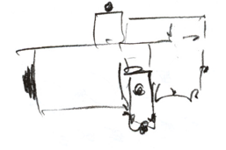
7. LOCAL SYMMETRIES
is the way that the intensity of a given center is increased by the extent to which other smaller centers which it contains are arranged in locally symmetrical groups.

Slide 35
7. LOCAL SYMMETRIES
Social Interaction
Space
Content
Time
Peer-to-peer work, twinning
Inner/Outer circle
1 Poster for every group
Every presentation same time frame

Slide 36
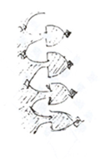
8. DEEP INTERLOCK AND AMBIGUITY
is the way in which the intensity of a given center can be increased when it is attached to nearby strong centers, through a third set of strong centers that ambiguously belong to both.

Slide 37
8. DEEP INTERLOCK AND AMBIGUITY
Social Interaction
Space
Content
Time
Different roles: learner = teacher & vice versa
Circle rotation, part of inner/outer circle
Question focused on a problem (feedback/evalu-ation)
Fixed time schedules & personal presentation style

Slide 38
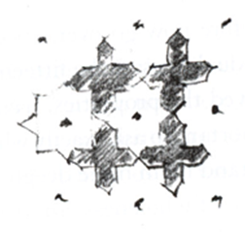
9. CONTRAST
is the way that a center is strengthened by the sharpness of the distinction between its character and the character of surrounding centers.

Slide 39
9. CONTRAST
Social Interaction
Space
Content
Time
Teacher vs. student groups
Inner/Outer circle
Group product vs. individual presentation, text vs. graph
60‘ vs. 5‘

Slide 40
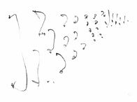
10. GRADIENTS
is the way in which a center is strengthened by a graded series of different sized centers which then “point” to the new center and intensify its field effect.

Slide 41
10. GRADIENTS
Social Interaction
Space
Content
Time
Increasing confidence & responsibility
Different locations provide different perspectives for a general subject
Small variation of every presen-tation leads to growing knowledge
Sequenced repetition of learned material (e.g. forgetting curve of Ebbinghaus)

Slide 42
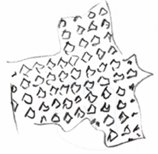
11. ROUGHNESS
is the way that the field-effect of a given center draws its strength, necessarily, from irregularities in the sizes, shapes and arrangements of other nearby centers.

Slide 43
11. ROUGHNESS
Social Interaction
Space
Content
Time
Individual characters of teachers/students
Every station has its individual properties
Short presentation provides rough summary
Within every time frame individual time management

Slide 44
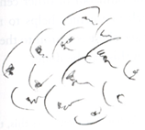
12. ECHOES
is the way that the strength of a given center depends on similarities of angle and orientation and systems of centers forming larger centers, among the centers it contains.

Slide 45
12. ECHOES
Social Interaction
Space
Content
Time
Socialization, incorporation of rules
Prototypes of a classroom adapted for specific method
Prior knowledge intensified and/or enhanced, redundance
Repetition

Slide 46
13. THE VOID
is the way that the intensity of every center depends on the existence of a still place—an empty center—somewhere in its field.

Slide 47
13. THE VOID
Social Interaction
Space
Content
Time
To concentrate/ to gather oneself
Way from one station to another
Starting the presentation with an empty poster
Recreational periods

Slide 48
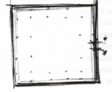
14. SIMPLICITY AND INNER CALM
is the way the strength of a center depends on its simplicity—on the process of reducing the number of different centers which exist in it, while increasing the strength of these centers to make them weigh more.

Slide 49
14. SIMPLICITY AND INNER CALM
Social Interaction
Space
Content
Time
No social distractions
Removing furniture
Simple & clear examples, to get directly to the point
Clear time structure

Slide 50
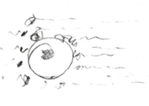
15. NOT-SEPARATENESS
is the way the life and strength of a center depends on the extent to which that center is merged smoothly—sometimes even indistinguishably—with the centers that form its surroundings.

Slide 51
15. NOT-SEPARATENESS
Social Interaction
Space
Content
Time
Awareness of being part of a group/a larger social system
Classroom as a part of larger spatial structure (e.g. school)
Embedded in a learning objective
Scenario as a part of curricula

Slide 52
“The Timeless Way of Building” is an early, intentionally vague attempt to suggest the “Quality without a name”
and “The Nature of Order” is a later, more refined attempt to
not only name it but to describe its taxonomy.
So talking about Pedagogical Pattern Language
requires thinking about and describing its taxonomy too.

Slide 53
Playing with
Alexander’s 15 properties forms the basis for a new educational taxonomy.

Slide 54
This slide set is licensed under a Creative Commons license:
Thank you!
peter.baumgartner@donau-uni.ac.at
reinhard.bauer@donau-uni.ac.at
http://www.donau-uni.ac.at/imb
http://www.peter.baumgartner.name
Twitter: @pbaumgartner | @rebauer | @imb_duk

